Slide 1
What you need:
Note paper (loose)
Blue/Black Pen
OPTIONAL:
Highlighter
Post-It notes

Slide 2
On the back of your handout…
Think back to a time that you really struggled with reading a text (of any length, genre or topic). What caused the difficulty? What did you do to try to overcome the challenge? Were you successful?
You are writing in blue/black pen, in cursive and your goal is to write at least 2 paragraphs! ☺

Slide 3
Close Reading

Slide 4
“A Connecticut Yankee in King Arthur’s Court”
1. Read the passage
2. What’s the main idea?

Slide 5
What is close reading?
Close reading is thoughtfully and actively reading and analyzing a text for better understanding. The reader writes responses and comments on the text or on a post-it. This is called annotating.

Slide 6
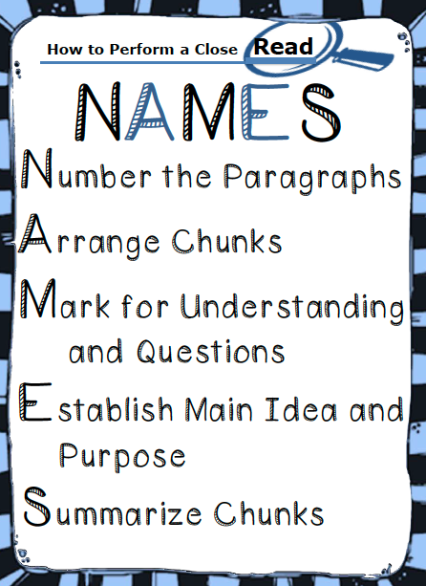

Slide 7
Before You Read:
Number the paragraphs for easy reference
Break the text up into sections, called “chunks”. A chunk could be a paragraph or more. Draw a line under each chunk.

Slide 8
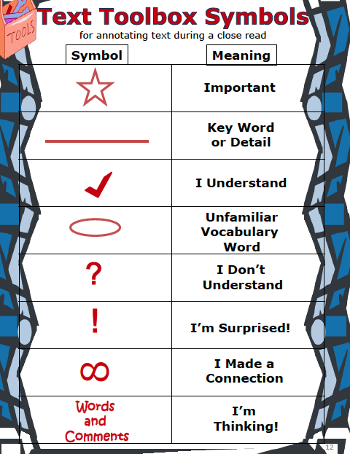
As you read… Use Text Toolbox Symbols
Individuals who use these types of markings as they read can dramatically improve their comprehension and reasoning skills.

Slide 9
Read the Passage Mark the Following
On the left:
CHECK what you understand.
On the right:
QUESTION parts you don’t understand

Slide 10
Reread the Text Mark the Following
Mark key words and details by UNDERLINING
CIRCLE unfamiliar words
Mark parts that are interesting or surprising with a !
On the left:
SUMMARIZE (in words) each chunked section
On the right:
CONNECT the text you know with what you already know
Find the main idea
Write down any new questions the text raises

