Slide 1
Journal…
What is the purpose of email? Why do you/don’t you use it? Who do you email? How frequently do you use this form of communication? If you don’t have email, why not?
How is writing an email different from writing an essay or a letter?

Slide 2
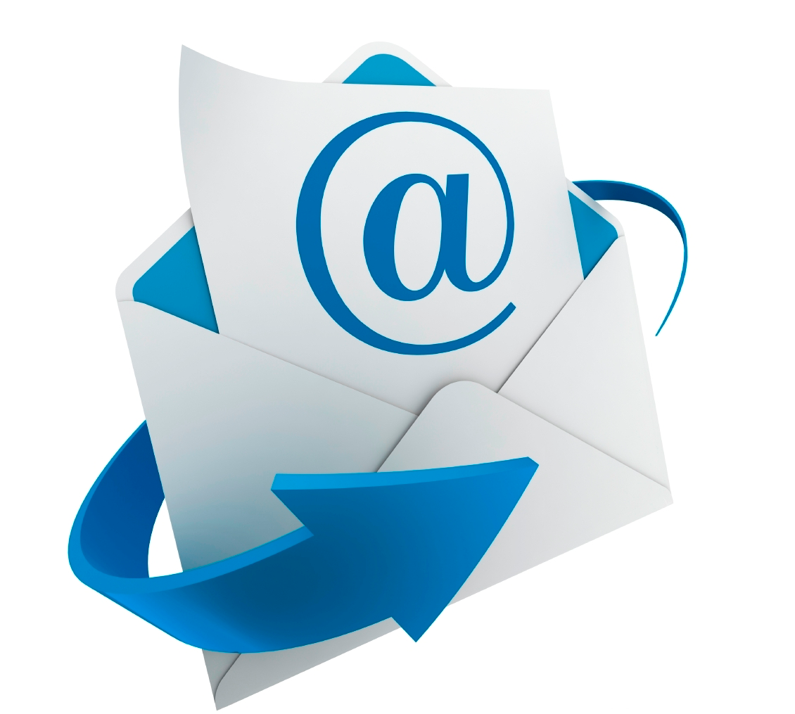
Em@il Netiquette
English

Slide 3
An e-mail I recently received:
is there any way i could make up my missed assignments and get them to you because im worried im going to fail
What’s wrong with this email?

Slide 4
Another email:
i didn’t understand today’s material on thesis writing. Explain this.
What’s wrong with this email?

Slide 5
Another email:
attachement*
What’s wrong with this email?

Slide 6
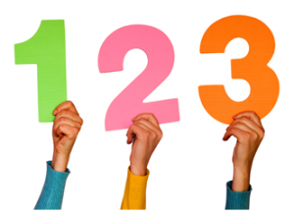
Email – Mind Your Manners
If you’re writing an email to a teacher or business person, it’s probably because you want something from that person.
Follow these 3 steps!

Slide 7
Step 1 – Identify Yourself
The recipient probably has hundreds of contacts. Your opening line should include your name and the context of your relationship.
Dear Mr. Smith,
My name is Sally Student, a freshman at Roosevelt High School. I enjoyed meeting you at last weekend’s Summit workshop for teens.

Slide 8
Step 2 – Write Efficiently
•Keep it simple
•If the bulk of the message is too long, the recipient might just skim or even trash your message without finishing it.
•Avoid sarcasm or attempts at humor; both are seen as unprofessional

Slide 9
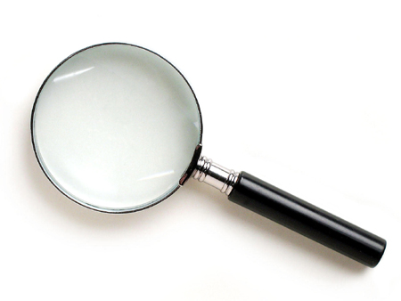
Step 3 – Proofread
• Did you splel chekc your email?
• Reread with an ear for tone. Could someone misinterpret your meaning? If so, rewrite.
• Stay classy
Use salutations, consider if your request is reasonable, include a polite sign-off, avoid text talk (ex: LOL)

Slide 10
A few more things…
Use a professional email address
gummybears4ever@hotmail.com rstevenson@gmail.com
Use a clear subject line
this helps the recipient quickly know what you need
Remember email is forever

Slide 11
A few more things…
Avoid emoticons :) = :(
seen as unprofessional; use actual words to express emotion
ALL CAPS = BAD! Don’t yell at people!
Be patient – Unwritten “24-48 hour rule” You may need an answer right away, but the recipient is busy, too. Avoid the “Did you get my email?” email. Give the recipient at least two days to respond.

Slide 12
Now, let’s see how this looks in the real world.
Evaluate four emails that I’m going to hand out now.
Be sure to follow the directions!

Slide 13
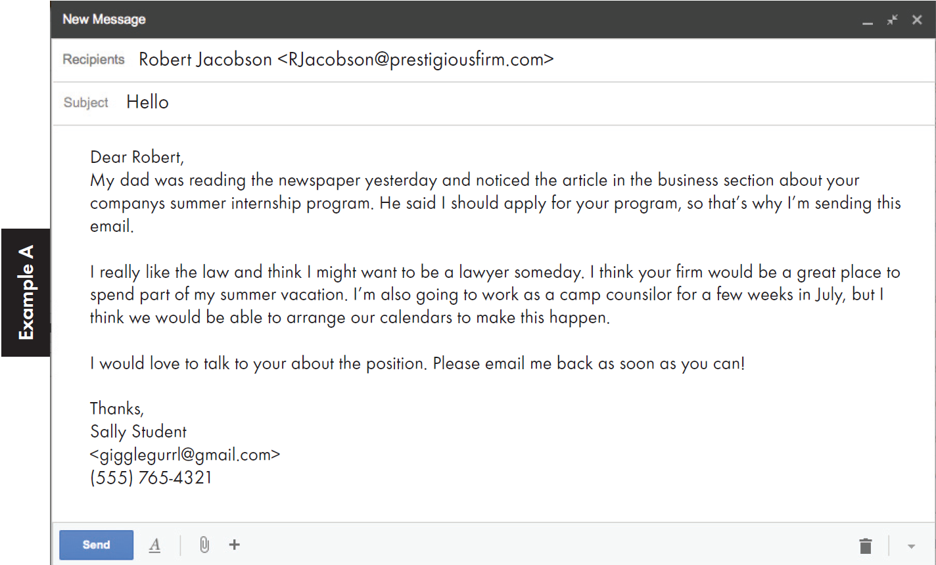

Slide 16
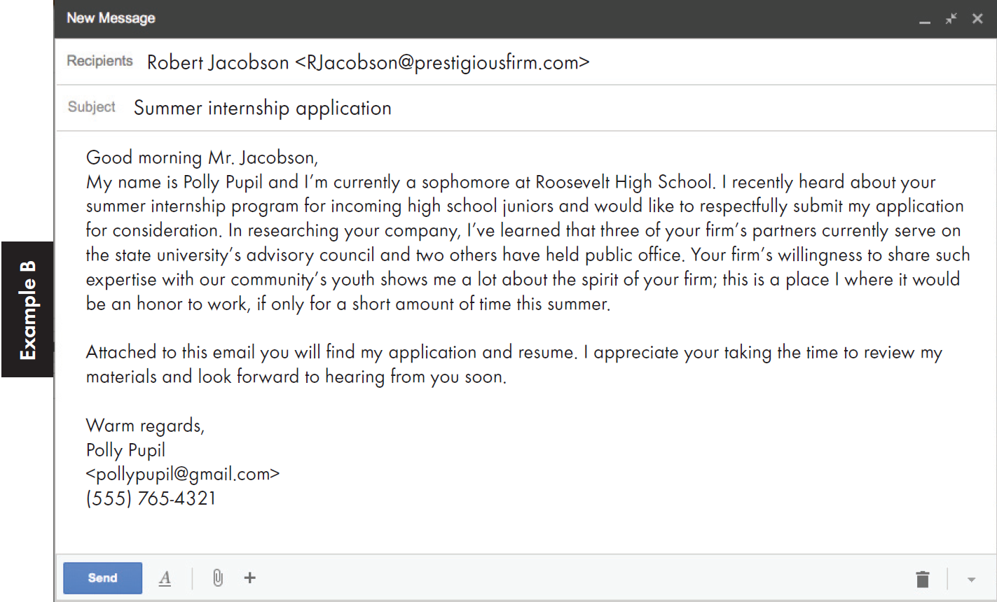

Slide 18
