Slide 1
40 Picture Writing Prompts {Use these journal prompts to help facilitate creative writing!}
Created By: Ms. Brittany Wheaton

Slide 2
The American Flag
What Do You See?
1.) In your opinion, what does the American flag symbolize?
2.) What do you think people who live in other countries think when they see the American flag?
3.) Do you think America has a unique sense of pride in its nation?

Slide 3
African Daisy
What Do You See?
1.) What THREE words come to mind when you see this photo? Explain why.
2.) If you could be anything in nature, what would you choose to be? Ex: flower, tree, rain, etc. Why?
3.) Do you think it is important to keep our outdoors clean and preserve nature?

Slide 4
Alpacas
What Do You See?
1.) For one full minute, write about your initial thoughts when you first looked at this photo.
2.) Label your paper 1-4 and create a caption, or catch phrase, for each of the alpacas. (Essentially, you are writing what each alpaca is thinking as they are getting their picture taken)

Slide 5
Apollo 11
What Do You See?
Some people believe that we never really landed on the moon. They claim that NASA faked the landings.
1.) Why do you think some people believe this theory?
2.) What is your opinion? Do you think we landed on the moon? Why or why not?

Slide 6
Basalt Cave
What Do You See?
Imagine you were asked to travel deep inside a dark cave in order to find buried treasure that would make you filthy rich. However, you have heard horror stories about terrible things that happen inside the cave.
1.) Would you continue the pursuit of the treasure? Why?
2.) Write/create a plan of action.

Slide 7
Beach House After Hurricane
What Do You See?
Unfortunately, natural disasters are something that are out of our control. However, there are things we can do to prepare for them.
1.) Imagine you and your family were just informed to evacuate your home. Create a list of 10 items you would bring with you. Explain why you chose each item.

Slide 8
Fireworks
What Do You See?
1.) What do you think of when you see fireworks? Why?
2.) In your opinion, what do fireworks symbolize?
3.) Do you have any memories where fireworks were present? Tell us about your memory.

Slide 9
Journal
Interpret: “Do, or do not. There is no ‘try’”
Empathy: Putting yourself in someone else’s shoes, and trying to understand how they may feel. Write about a time when you needed someone’s empathy.
On 8/21/1959, Hawaii became the 50th state! Hawaii stands out because it is an island separated from the mainland of the US. What makes your state stand out from other states?

Slide 10
Journal
Interpret:
“The best way out is always through.” – Robert Frost
- Tolerance: Patience toward something or someone that you don’t agree with or understand. Give an example of tolerance.
- The first Monday in September is Labor Day. Your job right now is to get an education. Make a list of all the “work” you do in a day at school. Be thoughtful.

Slide 11
What Do You See?
1.) What do you think this young man’s thought process is?
2.) What do you think the duck’s thought process is?
3.) Create a conversation between the two.

Slide 12
Carnival
What Do You See?
1.) What month do you think of when you see this picture? Why?
2.) Jot down all of the things (food, games, rides, etc) you think of when you go to a carnival.
3.) Write about a memory you have after seeing this picture.

Slide 13
Chinese Dragons
What Do You See?
In the Chinese culture, it is a huge compliment to be compared to a dragon. It means you are a very powerful creature.
1.) If you could compare yourself to a mythical creature or an animal, which would you choose? Why? Explain your answer in detail.

Slide 14
What Do You See?
Some people consider themselves a “dog” person or a “cat” person.
1.) Which are you? Why?
2.) What do you think this dog is thinking at the time of the picture? Explain your answer.

Slide 15
Eskimos
What Do You See?
1.) Choose one of people in the image. For the next 5 minutes, free write about what you think that person’s life was like prior to the photograph. Pretend as though you ARE that person; Therefore, you will be writing in first person as the person you choose.

Slide 16
Kayak
What Do You See?
People have different hobbies that they turn to in order to relieve stress; for example: kayaking.
1.) What do you do in order to relieve stress? Why?
2.) If you could be anywhere in the world right now, where would you be? Explain.

Slide 17
Finish Line
What Do You See?
1.) What goals do you have in life? Write about 3 of them.
2.) What emotions do you feel when you complete a difficult task? Does that motivate you? Why or why not?
3.) When you graduate, what do you want to accomplish in the “real world”?

Slide 18
Family
What Do You See?
1.) Choose one of the family members. Write what you think that family member is thinking.
2.) What is your personal definition of the word “family”? Do you think a person has to be related by blood to be considered family? Why or why not?

Slide 19
Foggy Sunset
What Do You See?
1.) Write 5 words that come to mind when you see this picture.
2.) Create a poem using those 5 words.
3.) Underline or highlight the 5 words.

Slide 20
What Do You See?
Meet “Grumpy Cat”!
1.) Write 10 quotes you think this cat might be thinking at the time of this picture.
2.) Have you seen this cat on different social networking sites? What do the captions typically say?

Slide 21
Hot Air Balloons
What Do You See?
1.) What is your definition of an adventure?
2.) Of the following, which would you be most apt to take part in? Why?
-A hot air balloon ride
- Skydiving
- Scubadiving
- Bungee Jumping

Slide 22
What Do You See?
Think of 4 important people in your life. Assign each of those people (and yourself) to one of the animals in the picture. Explain your reasoning!

Slide 23
Hurricane Katrina
What Do You See?
Hurricane Katrina was a natural disaster that affected a lot of families in New Orleans– including this father and son.
1.) If given the opportunity, what would you do to help a community in need during a natural disaster?
2.) What can you do today to help those in need?

Slide 24
Rainbow
What Do You See?
It is believed that there is a “pot of gold” at the end of every rainbow.
1.) If you could find the end of a rainbow, what would you hope to find instead of gold? (for example: a ton of gorgeous shoes)
2.) What do you think of when you see a rainbow? Why?

Slide 25
Santa Claus
What Do You See?
1.) Write 5 words that you think of when you see this picture. Explain why.
2.) What kind of traditions do you celebrate in your family? (does not have to be related to a holiday)

Slide 26
What Do You See?
“We must use time wisely and forever realize that the time is always ripe to do right.” -Nelson Mandela
1.) How do you interpret this quote?
2.) Do you think there is such thing as wasting time? If so, what is considered a waste of time?

Slide 27
Bowling
What Do You See?
Sports are very important in American culture.
1.) What is your favorite sport? Why?
2.) Do you think professional athletes should have a salary cap? Why or why not?
3.) Have you ever been to a professional sporting event? Describe the feeling.

Slide 28
Holocaust Victims
What Do You See?
1.) Write down everything you know about the Holocaust.
2.) What feelings do you experience as you look at this photograph? Why do you think you experience those feelings?
3.) Put yourself in the shoes of one of the victims. What are you thinking? How do you feel?

Slide 29
What Do You See?
1.) Imagine you could live in any castle, mansion, or house that you wanted. Describe your home in detail. What would it look like? How many rooms? What kind of rooms?

Slide 30
E-Card Meme
What Do You See?
If you look on the internet at social networking sites like Facebook, Twitter, or Pinterest, you will see pictures, or memes, that highlight something common within society.
1.) Create a list of the memes you have seen.
2.) Do you think memes highlight the truth about society or a just made for humor? Explain.

Slide 31
Civil War Photograph
What Do You See?
1.) What do you know about the civil war?
2.) Do you think that we, as a society, learn from out past?
3.) Create your own definition of “history”.

Slide 32
Downtown City Lights
What Do You See?
1.) List 3 words that come to mind when you see this picture. Why?
2.) Would you rather live in the city or in the country? Explain your answer.
3.) If you could live anywhere in the world, where would you live? Any particular reason why?

Slide 33
Man Playing an Organ
What Do You See?
“Everybody has that point in their life where they hit a crossroads and have had a bunch of bad days and there's different ways you can deal with it and the way I dealt with it was I just turned completely to music.” -Taylor Swift
1.) What kind of music do you listen to? Why? How does it make you feel?
2.) Other than music, what do you turn to when you’ve had a bad day? Why?

Slide 34
Anne Frank
What Do You See?
Anne Frank is known for her journal entries written during the Holocaust.
1.) Imagine being in Anne’s situation. Write 2 full journal entries as though you were in the same situation as Anne. Be detailed!

Slide 35
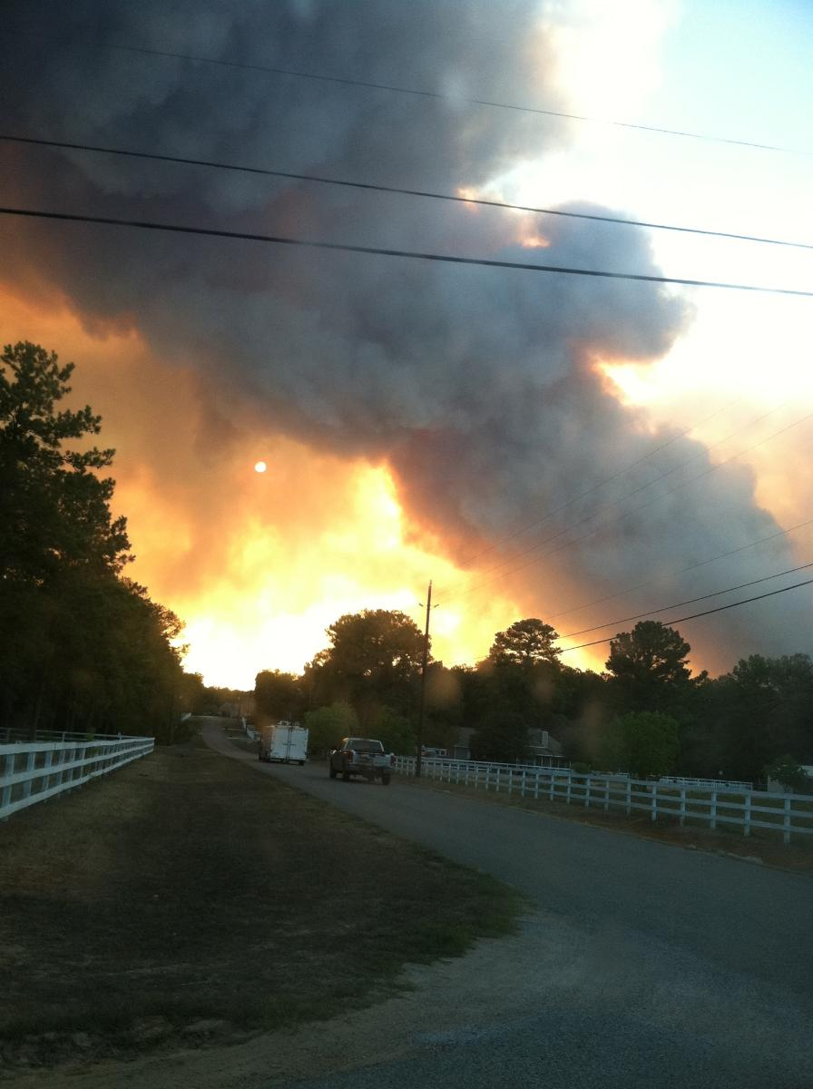
What Do You See?
This is a photograph of a wild fire in Magnolia, Texas. Imagine you are the person taking the photo from your driveway. What is your train of thought? Explain in detail what you are thinking and what you plan on doing immediately after taking the photograph.

Slide 36
Kitten Being Rescued
What Do You See?
During times of tragedy, humans are typically the first concern. This photograph highlights a woman who saved what looks to be a newborn kitten.
1.) What are your views on animal rights?
2.) Tell us about your animal(s) and what they mean to you.

Slide 37
Children and Teacher
What Do You See?
1.) What do you think of when you look at this picture?
2.) What do you think the children are learning about? Why?
3.) Tell us about one of your best teachers. Why was he/she considered the best?
4.) How do you learn best? (ex: projects, worksheets, etc)

Slide 38
Volcano
What Do You See?
1.) For one minute, free write about what you see in this photograph.
2.) Have you ever felt like a volcano ready to erupt? Write about a time where you had to control your anger and emotions. What was it like? How did you cope?

Slide 39
From the movie Grease
What Do You See?
1.) Looking at the picture, what do you think the movie Grease is about? Why?
2.) What is your favorite movie? Why?
3.) Are there any movies your are excited about seeing? Write about them.

Slide 40
Full Moon
What Do You See?
1.) What do you think of when you see a full moon? Why?
2.) Write a short story in which a full moon is present. Where does it take place? What is the mood/tone of the story? (at least 3 full paragraphs)

Slide 41
What Do You See?
1.) What do you think he found? Describe in detail what you think the child sees.
2.) What is your favorite childhood memory?
4.) Who do you think is taking the picture? Why?

Slide 42
Waves Crashing
What Do You See?
“Success comes in waves.” -Guy Pearce
1.) Do you agree with this quote? Why or why not?
2.) Have you ever felt like your life is one big wave? Up and down, up and down. Explain a time where you felt like a crashing wave.
3.) If you look closely, you can see 2 people standing on the dock. What are they thinking as the wave crashes right in front of them?

Slide 43
Credits!
All photographs used are public domain images.
No photographs violate copyright laws.
A special thank you to “Glitter Meets Glue” for their wonderful glitter backgrounds! Visit their store for more awesome designs: http://www.teacherspayteachers.com/Store/Glitter-Meets-Glue-Designs

Slide 44
Thank You!
Thank you so much for purchasing one of my products! I hope you find great use out of these 40 picture writing prompts. If you have any questions, please feel free to e-mail me.
To discuss best practices in the classroom, visit my Facebook page: http://www.facebook.com/TheSuperheroTeachersResources
Enjoy! ☺

